Slide 1
4 step process to access your school desktop

Slide 2
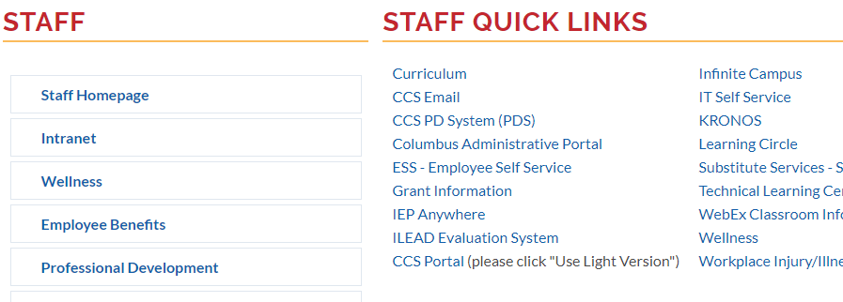
Open up Staff home page and click on CCS Portal (please click “Use Light Version”

Slide 3
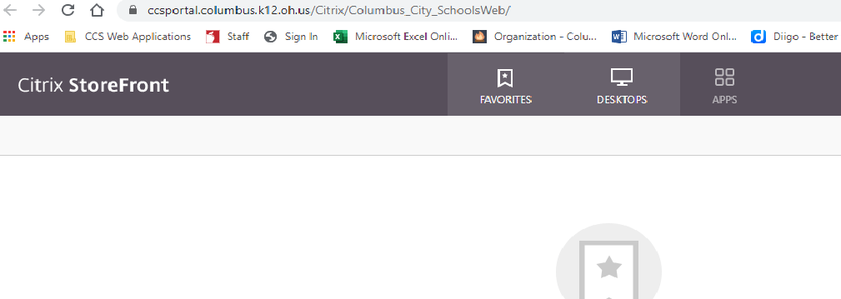
Select Desktop

Slide 4
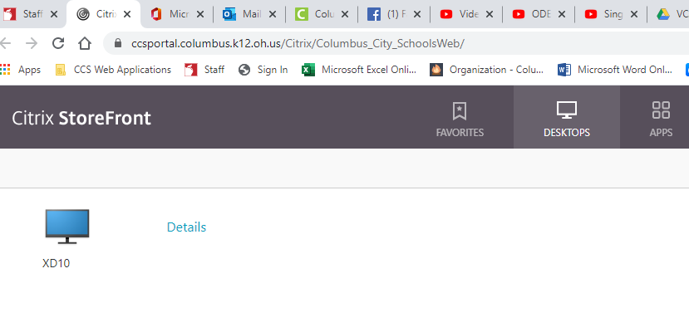
Select your desktop from your school computer

Slide 5
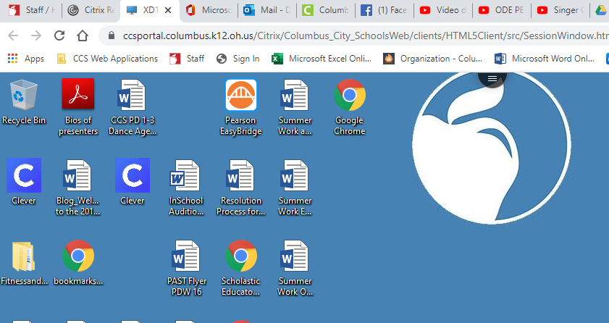
You can now see your school’s computer desktop

Slide 6
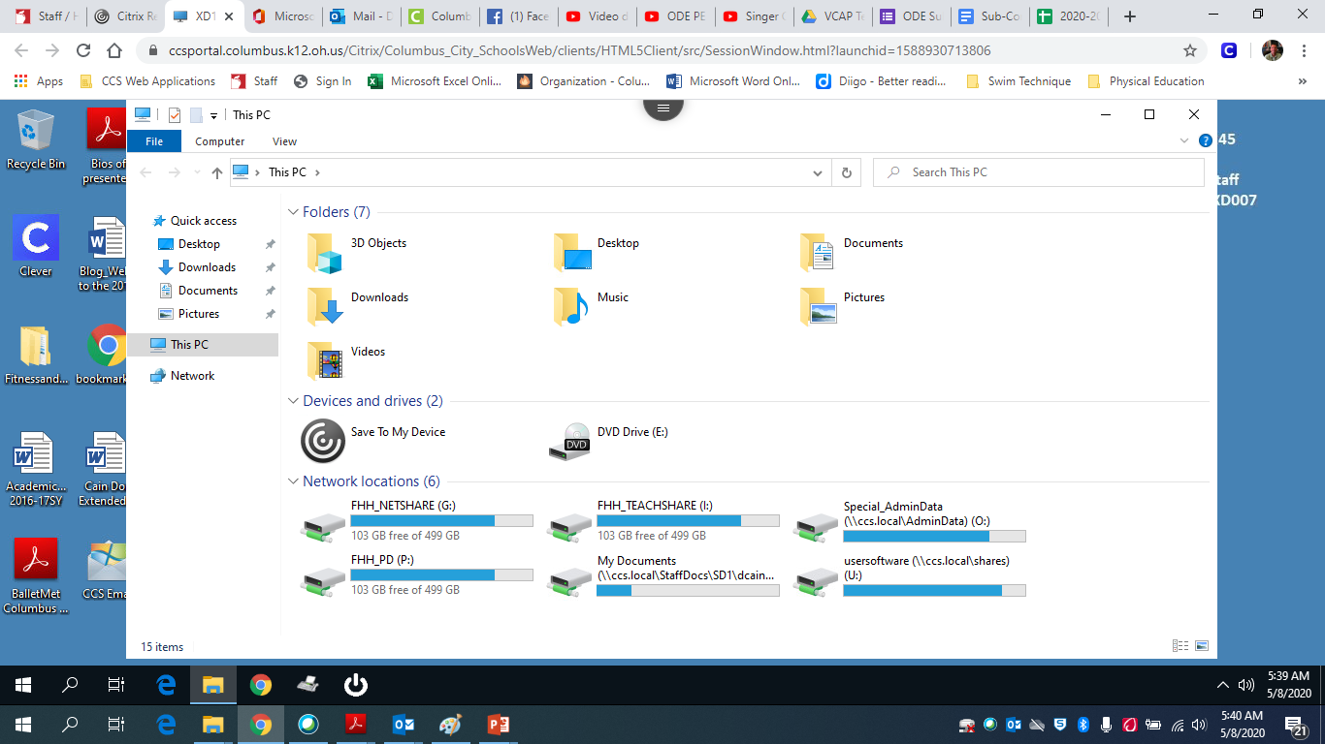
Click to access your Files

